Slide 1
writing your own function.
Week 1 | Lecture 2 (1.2.2)
While waiting for class to start:
Download and open the Jupyter Notebook (.ipynb) for Lecture 1.2.2
You may also use this lecture’s JupyterHub link instead (although opening it locally is encouraged).
Upcoming:
Lab 1 released (Gradescope invites coming...)
Reflection 1 released Friday
PRA (Lab) on Friday @ 2PM this week
Notes:
Piazza link error
what do you want to learn, why are you here - who is really interested in programming hopes to do this later,
who is curious about it but maybe is in a different discipline and doesn't think they'll continue
who is totally not stoked about being here and hates computers and is just taking this course for the sake of it
what do you want to learn? what do you want to get out of this course? what would be interesting?
we'll have our first design problem today which looks at kinematics and robotics, a very similar algorithm used by the canadarm.
later we have design problems on creating Wordle from scratch. also a sports analytics themed design problem.

Slide 2
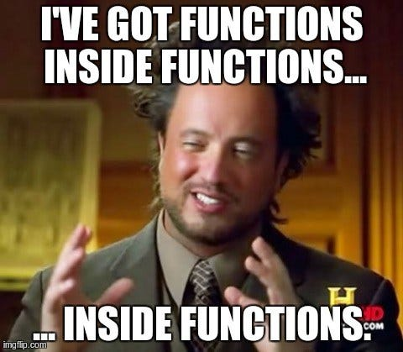
What you’ll learn today
Lecture 2.1
Functions, input & output, importing modules
Lecture 2.2
Writing your own functions
Local vs global scope

Slide 3
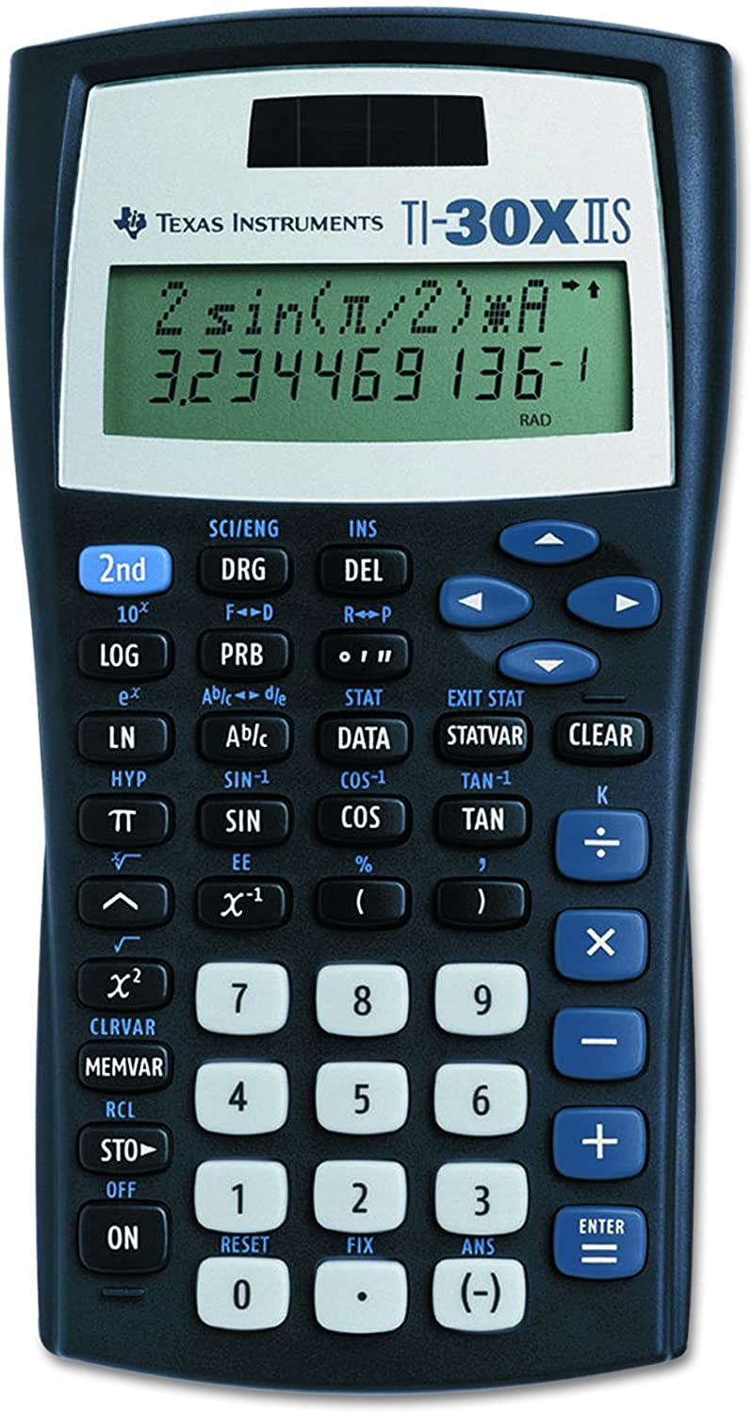
What is a function?
A function is a piece of code that you can “call” repeatedly to do one thing.
Think about the sine key on your calculator. It takes in an angle, does some calculations and returns the sine of that angle.
Python has built-in functions (today), but programmers can also create their own user-defined functions (next lecture).

Slide 4
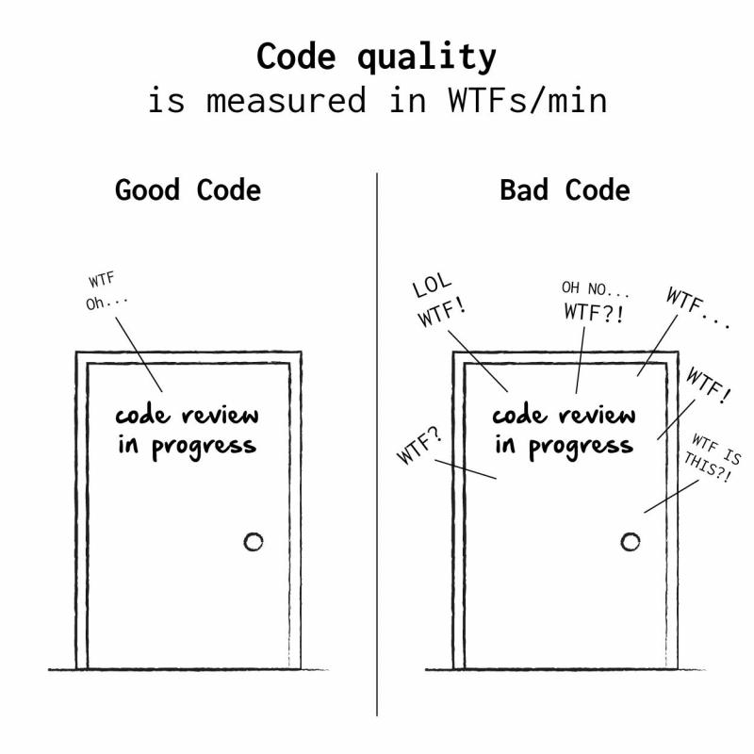
Defining Your Own Functions
The real power of functions is in defining your own.
Good programs typically consist of many small functions that call each other.
If you have a function that does only one thing (like calculate the sine of an angle), it is likely not too large.
If its not too large, it will be easy to test and maintain.

Slide 5
Function Definitions
(parameter1,
parameter2, …)
Definition
Function Name
Colon
def function_name(parameters):
“““DOCSTRING”””
body
return
Indent
Docstring (Optional)
What are we returning?
What is in the body?

Slide 6
Function Definitions
def function_name(parameters):
body
return
def - is a keyword, standing for "definition". All function definitions must begin with def. The def statement must end with a colon.
function_name - is the name you will use to call the function (like sin, abs but you need to create your own name).
parameters - are the variables that get values when you call the function. You can have 0 or more parameters, separated by commas. Must be in parenthesis.
body - body is a sequence of commands like we've already seen (assignment, multiplication, function calls).
return – ends the function and returns data (like the sine of an angle.
Important: all the lines of body must be indented. That is how Python knows that they are part of the function.

Slide 7
Calling Functions
The stuff we pass to the function.
Arguments
The general form of a function call:
Terminology
argument: a value given to a function.
pass: to provide an argument to a function.
call: ask Python to execute a function (by name).
return: give a value back to where the function was called from.
function_name(arguments)
Function
Call
Function
()
function_name()
function_name
Would not result in a function call.
The stuff the function returns to us after we call it.
Returns

Slide 8
Function Definitions
Calling Functions
def function_name(parameters):
body
return
def square(x):
return x * x
function_name(arguments)
square(2)
2 is the argument (data) passed to the square function.
x is the parameter.

Slide 9
Function Definitions
def function_name(parameters):
1. “““DOCSTRING””” (optional)
2. Code that does the thing
3. return expression
The return statement is optional and if it is not included, it’s the same as writing return None
Open your notebook
Click Link:
1. Defining Your Own Functions

Slide 10
Variable Scope
A variable is only available from inside the region it is created, which is called the variable’s scope.
Python has four different scopes, and we will discuss the two most important for this course.
Local Scope
Global Scope
Global
Local
Variable Lookup

Slide 11
Variable Scope
Local Scope
Whenever you define a variable within a function, its scope lies ONLY within the function.
It is accessible from the point at which it is defined until the end of the function and exists for as long as the function is executing.
This means its value cannot be changed or even accessed from outside the function.
Global
Local
Variable Lookup

Slide 12
Local Scope
Example 1
What will happen when this code is run?
def my_function():
name = ‘Sebastian’
my_function()
print(name)

Slide 13
Local Scope
Example 1
def my_function():
name = ‘Sebastian’
my_function()
print(name)
>>> Error
name is local to the function and not accessible outside in the global scope.

Slide 14
Local Scope
Example 1
Global
def my_function():
name = ‘Sebastian’
my_function()
print(name)

Slide 15
Local Scope
Example 1
Global
def my_function():
name = ‘Sebastian’
my_function()
print(name)
Local
(my_function)

Slide 16
Local Scope
Example 1
Global
def my_function():
name = ‘Sebastian’
my_function()
print(name)
Local
(my_function)
name = “Sebastian”

Slide 17
Local Scope
Example 1
Global
def my_function():
name = ‘Sebastian’
my_function()
print(name)
>>> Error
Local
(my_function)
name = “Sebastian”
Variable Lookup
Is name in global?
No (Done)
Error: builtins.NameError: name 'name' is not defined

Slide 18
Local Scope
Example 2
What will happen when this code is run?
def my_function():
name = ‘Sebastian’
my_function()
name = ‘Ben’
print(name)

Slide 19
Local Scope
Example 2
What will happen when this code is run?
def my_function():
name = ‘Sebastian’
my_function()
name = ‘Ben’
print(name)
>>> Ben

Slide 20
Local Scope
Example 2
Global
def my_function():
name = ‘Sebastian’
my_function()
name = ‘Ben’
print(name)

Slide 21
Local Scope
Example 2
Global
def my_function():
name = ‘Sebastian’
my_function()
name = ‘Ben’
print(name)
Local
(my_function)

Slide 22
Local Scope
Example 2
Global
def my_function():
name = ‘Sebastian’
my_function()
name = ‘Ben’
print(name)
Local
(my_function)
name = “Sebastian”

Slide 23
Local Scope
Example 2
Global
name = “Ben”
def my_function():
name = ‘Sebastian’
my_function()
name = ‘Ben’
print(name)
Local
(my_function)
name = “Sebastian”

Slide 24
Local Scope
Example 2
Global
name = “Ben”
def my_function():
name = ‘Sebastian’
my_function()
name = ‘Ben’
print(name)
>>> Ben
Local
(my_function)
name = “Sebastian”
Variable Lookup
Is name in global?
Yes (Done)

Slide 25
Variable Scope
Local Scope
Whenever you define a variable within a function, its scope lies ONLY within the function.
It is accessible from the point at which it is defined until the end of the function and exists for as long as the function is executing.
This means its value cannot be changed or even accessed from outside the function.
Open your notebook
Click Link:
2. Local Scope

Slide 26
Variable Scope
Global Scope
Whenever a variable is defined outside any function, it becomes a global variable, and its scope is anywhere within the program.
This means that variables and functions defined outside of a function are accessible inside of a function.
Global
Local
Variable Lookup

Slide 27
Global Scope
Example 1
What will happen when this code is run?
def my_function():
print(name)
name = ‘Sebastian’
my_function()

Slide 28
Global Scope
Notice that name is not defined anywhere in the function.
Example 1
What will happen when this code is run?
def my_function():
print(name)
name = ‘Sebastian’
my_function()
>>> Sebastian
name is in the global scope and is accessible inside the function.

Slide 29
Global Scope
Example 1
Global
def my_function():
print(name)
name = ‘Sebastian’
my_function()

Slide 30
Global Scope
Example 1
Global
def my_function():
print(name)
name = ‘Sebastian’
my_function()
Local
(my_function)

Slide 31
Global Scope
Example 1
Global
name = “Sebastian”
def my_function():
print(name)
name = ‘Sebastian’
my_function()
Local
(my_function)

Slide 32
Global Scope
Example 1
Global
name = “Sebastian”
def my_function():
print(name)
name = ‘Sebastian’
my_function()
Local
(my_function)
Variable Lookup
Is name in local?
No

Slide 33
Global Scope
Example 1
Global
name = “Sebastian”
def my_function():
print(name)
name = ‘Sebastian’
my_function()
>>> Sebastian
Local
(my_function)
Variable Lookup
Is name in local?
No
Is name in global?
Yes (Done)

Slide 34
Global Scope
Example 2
What will happen when this code is run?
def my_function():
name = ‘Ben’
print(name)
name = ‘Sebastian’
my_function()

Slide 35
Global Scope
Example 2
What will happen when this code is run?
def my_function():
name = ‘Ben’
print(name)
name = ‘Sebastian’
my_function()
>>> Ben
name is in the local and global scope. Python will use the local version.

Slide 36
Global Scope
Example 2
Global
def my_function():
name = ‘Ben’
print(name)
name = ‘Sebastian’
my_function()

Slide 37
Global Scope
Example 2
Global
def my_function():
name = ‘Ben’
print(name)
name = ‘Sebastian’
my_function()
Local
my_function

Slide 38
Global Scope
Example 2
Global
name = ‘Sebastian’
def my_function():
name = ‘Ben’
print(name)
name = ‘Sebastian’
my_function()
Local
my_function

Slide 39
Global Scope
Example 2
Global
name = ‘Sebastian’
def my_function():
name = ‘Ben’
print(name)
name = ‘Sebastian’
my_function()
>>> Ben
Local
my_function
name = ‘Ben’
Variable Lookup
Is name in local?
Yes (Done)

Slide 40
Global Scope
Example 3
What will happen when this code is run?
def my_function():
print(name)
my_function()

Slide 41
Global Scope
Example 3
What will happen when this code is run?
def my_function():
print(name)
my_function()
>>> Error
name is not defined in the local or global scope.

Slide 42
Global Scope
Global
def my_function():
print(name)
my_function()

Slide 43
Global Scope
Global
def my_function():
print(name)
my_function()
Local
my_function

Slide 44
Global Scope
Global
def my_function():
print(name)
my_function()
Local
my_function
Variable Lookup
Is name in local?
No

Slide 45
Global Scope
Global
def my_function():
print(name)
my_function()
>>> Error
Local
my_function
Variable Lookup
Is name in local?
No
Is name in global?
No

Slide 46
Variable Scope
Notice that name is not defined anywhere when we define the function.
Global Scope
Global
def my_function():
print(name)
name = ‘Sebastian’
my_function()
Local
name is in the global scope and is accessible inside the function.
Variable Lookup
Is name in local?
No
Is name in global?
Yes (Done)
OUTPUT: Sebastian

Slide 47
Variable Scope
Global Scope
Global
def my_function():
name = ‘Ben’
print(name)
name = ‘Sebastian’
my_function()
Local
name is in the global scope and is accessible inside the function.
Variable Lookup
Is name in local?
Yes (Done)
OUTPUT: Ben

Slide 48
Variable Scope
Global Scope
Whenever a variable is defined outside any function, it becomes a global variable, and its scope is anywhere within the program.
This means that variables and functions defined outside of a function are accessible inside of a function.
Open your notebook
Click Link:
3. Global Scope

Slide 49
Design Recipe
How do we go about writing a function?
You should follow these six steps.
Examples (What do you want your function calls to look like?)
Type Contract (Specify the type(s) of parameters and return values)
Header (Decide on the name of the function)
Description (Write a short description of what the function does)
Body (Write the code that actually does the thing that you want)
Test (Verify the function using examples)

Slide 50
Design Recipe
Write a function that converts from Fahrenheit to Celsius.
1. Examples (What do you want your function calls to look like?)
celsius = convert_to_celsius(32)
celsius = convert_to_celsius(212)
celsius = convert_to_celsius(98.6)

Slide 51
Design Recipe
Write a function that converts from Fahrenheit to Celsius.
2. Type Contract (Specify the type(s) of parameters and return values)
def convert_to_celsius(degrees_f):
"""
...
"""
... Do something
return degrees_c
What types are passed in?
What types are returned?

Slide 52
Design Recipe
Write a function that converts from Fahrenheit to Celsius.
2. Type Contract (Specify the type(s) of parameters and return values)
def convert_to_celsius(degrees_f):
"""
(number) -> number
"""
... Do something
return degrees_c
What types are passed in? Number
What types are returned?
Number

Slide 53
Design Recipe
Write a function that converts from Fahrenheit to Celsius.
3. Header (Decide on the name of the function and parameters)
(you probably already did this in step 1)
def convert_to_celsius(degrees_f):
"""
(number) -> number
"""
... Do something
return degrees_c

Slide 54
Design Recipe
Write a function that converts from Fahrenheit to Celsius.
4. Description (Write a short description of what the function does)
def convert_to_celsius(degrees_f):
"""
(number) -> number
Return the temperature in degrees Celsius corresponding to
the degrees Fahrenheit passed in.
"""
... Do something
return degrees_c

Slide 55
Design Recipe
Write a function that converts from Fahrenheit to Celsius.
5. Body (Write the code that actually does the thing that you want)
def convert_to_celsius(degrees_f):
"""
(number) -> number
Return the temperature in degrees Celsius corresponding to
the degrees Fahrenheit passed in.
"""
degrees_c = (degrees_f - 32) * 5 / 9
return degrees_c

Slide 56
Design Recipe
Write a function that converts from Fahrenheit to Celsius.
6. Test (Verify the function using examples)
- Run all the examples that you created in Step 1.
- Testing is so important.
- In industry, you’ll be expected to provide tests for everything.
celsius = convert_to_celsius(32) # celsius should be 0
celsius = convert_to_celsius(212) # celsius should be 100
celsius = convert_to_celsius(98.6) # celsius should be 37.0

Slide 57
Design Recipe
https://utoronto.zoom.us/my/bussmann
https://utoronto.zoom.us/my/bussmann
How do we do about writing a function?
You should follow these six steps.
Type
Contract
Header
Description
Body
Test
Open your notebook
Click Link:
4. Design Recipe

Slide 58
Docstring
A Python documentation string, commonly known as docstring, helps you understand the capabilities of a function (or module, class).
def convert_to_celsius(degrees_f):
"""
(number) -> number
Return the temperature in degrees Celsius corresponding to
the degrees Fahrenheit passed in.
"""
degrees_c = (degrees_f - 32) * 5 / 9
return degrees_c
This is the docstring

Slide 59
Docstring
As we saw before, help() prints information about a function.
The help function actually prints out the “docstring” that we write as part of a function definition.
For the function we just wrote, we could type:
help(convert_to_celsius)
>>>
Help on function convert_to_celsius in module __main__:
convert_to_celsius(degrees_f)
(number) -> number
Return the temperature in degrees Celsius corresponding to the degrees
Fahrenheit passed in

Slide 60
Docstring
These are the most popular Docstrings format available.
Formatting Type | Description
NumPy/SciPy docstrings | Combination of reStructured and GoogleDocstrings and supported by Sphinx
PyDoc | Standard documentation module for Python and supported by Sphinx
EpyDoc | Render Epytext as series of HTML documents and a tool for generating API documentation for Python modules based on their Docstrings
Google Docstrings | Google's Style

Slide 61
Docstring
This can be very valuable:
For other programmers to figure out what a function is supposed to do.
For you in the future when you have forgotten what you wrote (this happens a lot!).
You should write a docstring for every function!
Remember good vs bad code review.
Open your notebook
Click Link:
5. Docstring

Slide 62
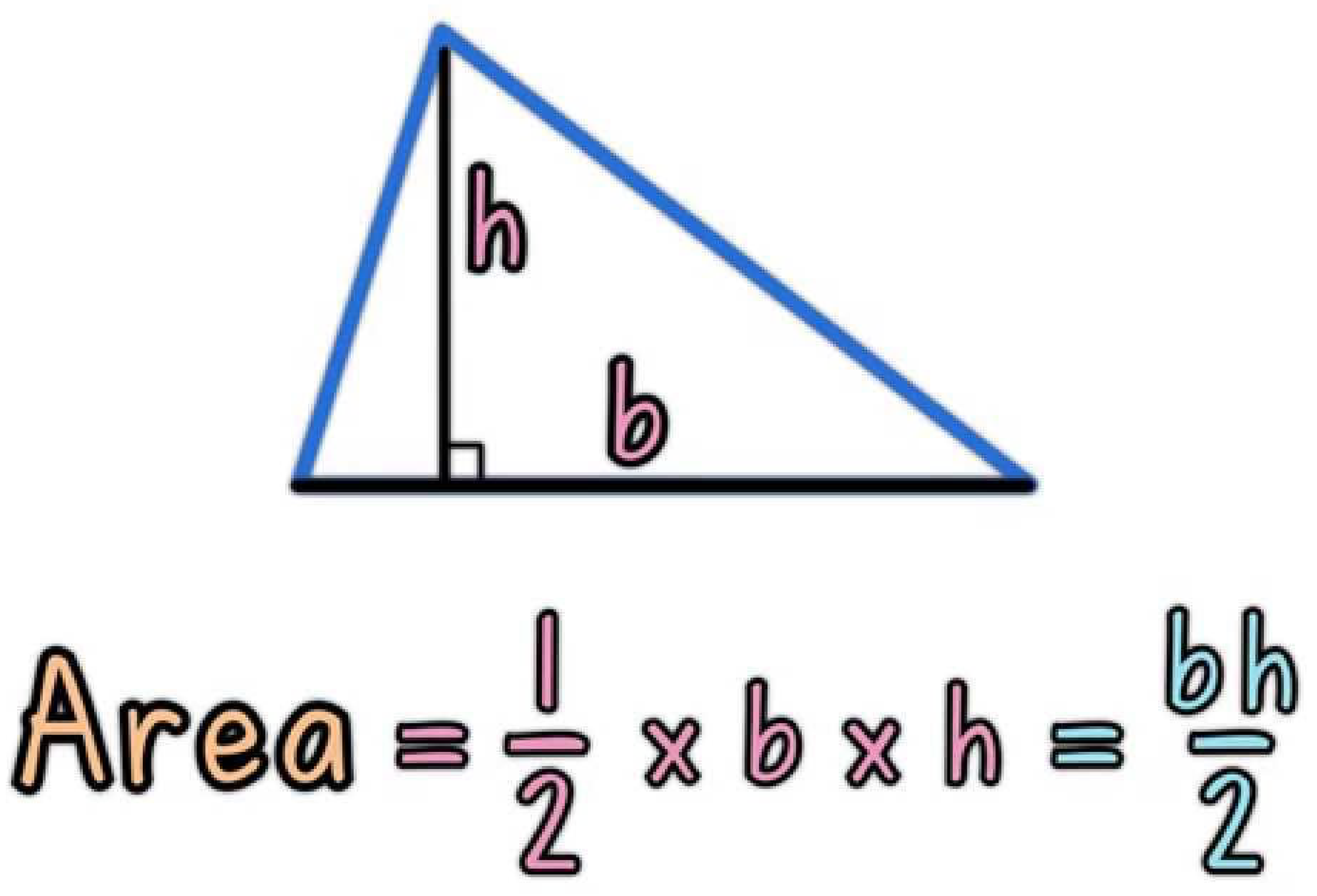
Breakout Session 1
Following the Design Recipe, write a function to calculate the area of a triangle.
Open your notebook
Click Link:
6. Breakout Session 1

Slide 63
More Stuff You Can Do With Functions
https://utoronto.zoom.us/my/bussmann
https://utoronto.zoom.us/my/bussmann
Nested Function Calls
Calling Functions within Functions
Open your notebook
Click Link:
7. Nested Function Calls
8. Calling Functions within Functions
print(3 + 7 + abs(-5))
Function
Function
Function Definition
def my_function():
print("Hello from a function")
Function

Slide 64
print v.s. return
The difference between print and return is a point of confusion year after year.
So, let’s be proactive and address this.
Are we the same?
Eww, no.
return
print

Slide 65
print
return
Use cases
Debugging.
Displaying messages to users.
Use cases
Used to end the execution of the function call and “return” the result.
Sends a function’s result back to where it was called
The entire function call evaluates to whatever is returned

Slide 66
print
return
def square(x):
output = x * x
print(output)
>>> square(2)
4
def square(x):
output = x * x
return output
>>> square(2)
4

Slide 67
print
return
The stuff we pass to the function.
Arguments: 2
The stuff we pass to the function.
Arguments: 2
def square(x):
output = x * x
print(output)
def square(x):
output = x * x
return output
Function
square
Function
square
The stuff the function returns to us after we call it.
The stuff the function returns to us after we call it.
Returns: None
Returns: 4

Slide 68
print v.s. return
Open your notebook
Click Link:
9. print v.s. return
def square(x):
output = x * x
print(output)
def square(x):
output = x * x
print(output)
return None
These two functions return the same thing.

Slide 69
From Functions to Programs
The recipe we discussed earlier highlights a few of the realities about programming whether for individual functions or for large pieces of software.
1. A formal design process (or even a recipe) can help.
Especially when you are writing a large program with many programmers, it is easy to get lost.
In fact, it is more often impossible to hold the entire program in your head.
Having a process helps you to figure out where you are and what you should do next.

Slide 70
From Functions to Programs
The recipe we discussed earlier highlights a few of the realities about programming whether for individual functions or for large pieces of software.
2. Functions can be written and then their insides can be forgotten about.
Do you know how Python calculates sin()?
Do you care?
You can successfully use functions without knowing how they are implemented if you know what they take in and what they return.
This is very important for large projects.

Slide 71
From Functions to Programs
The recipe we discussed earlier highlights a few of the realities about programming whether for individual functions or for large pieces of software.
3. Start with examples.
This helps in communication with the client, helps (a lot) to figure out what the problem really is, and is the core for testing your code.

Slide 72
From Functions to Programs
The recipe we discussed earlier highlights a few of the realities about programming whether for individual functions or for large pieces of software.
1. A formal design process (or even a recipe) can help.
Especially when you are writing a large program with many programmers, it is easy to get lost.
In fact, it is more often impossible to hold the entire program in your head.
Having a process helps you to figure out where you are and what you should do next.

Slide 73
From Functions to Programs
The recipe we discussed earlier highlights a few of the realities about programming whether for individual functions or for large pieces of software.
2. Functions can be written and then their insides can be forgotten about.
Do you know how Python calculates sin()?
Do you care?
You can successfully use functions without knowing how they are implemented if you know what they take in and what they return.
This is very important for large projects.

Slide 74
From Functions to Programs
The recipe we discussed earlier highlights a few of the realities about programming whether for individual functions or for large pieces of software.
3. Start with examples.
This helps in communication with the client, helps (a lot) to figure out what the problem really is, and is the core for testing your code.

Slide 75
A Design Process for Programming
Define the Problem.
Write down what the problem actually is.

Slide 76
writing your own function.
Week 1 | Lecture 2 (1.2.2)
Notes:
Piazza link error
what do you want to learn, why are you here - who is really interested in programming hopes to do this later,
who is curious about it but maybe is in a different discipline and doesn't think they'll continue
who is totally not stoked about being here and hates computers and is just taking this course for the sake of it
what do you want to learn? what do you want to get out of this course? what would be interesting?
we'll have our first design problem today which looks at kinematics and robotics, a very similar algorithm used by the canadarm.
later we have design problems on creating Wordle from scratch. also a sports analytics themed design problem.

